Slide 1
Personal Experience Using GIS with PowerBI
Mimoune Djouallah (mim)
PowerBI developer. ( Ex Construction Planner)
https://datamonkeysite.com/ (blogs about PowerBI, BigQuery, Oracle Primavera and a bit of Data Studio & Construction)
nemtracker.github.io : Dashboard to Track Australia Electricity Market
Twitter @mim_djo
Linkedin : https://www.linkedin.com/in/mimounedjouallah/

Slide 2
Plotting more than 30 K points and how Icon Map saved the Day
Aggregating Massive GIS datasets (Multi Point and Hexagon)
Nice GIS trick, filter by Distance and calculate Distance
Using Dynamic M parameter and Direct Query for GIS calculation

Slide 3
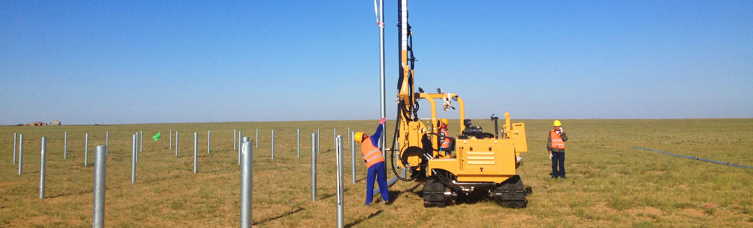
How it started
I Worked nearly 3 years in Solar farm Construction.
A Typical mid size Solar Farm has a lot of Piles usually > 30 K
No Aggregation, you need to see the status of every pile
PowerBI has a limit of 30K rows ( less for other Visual)

Slide 4
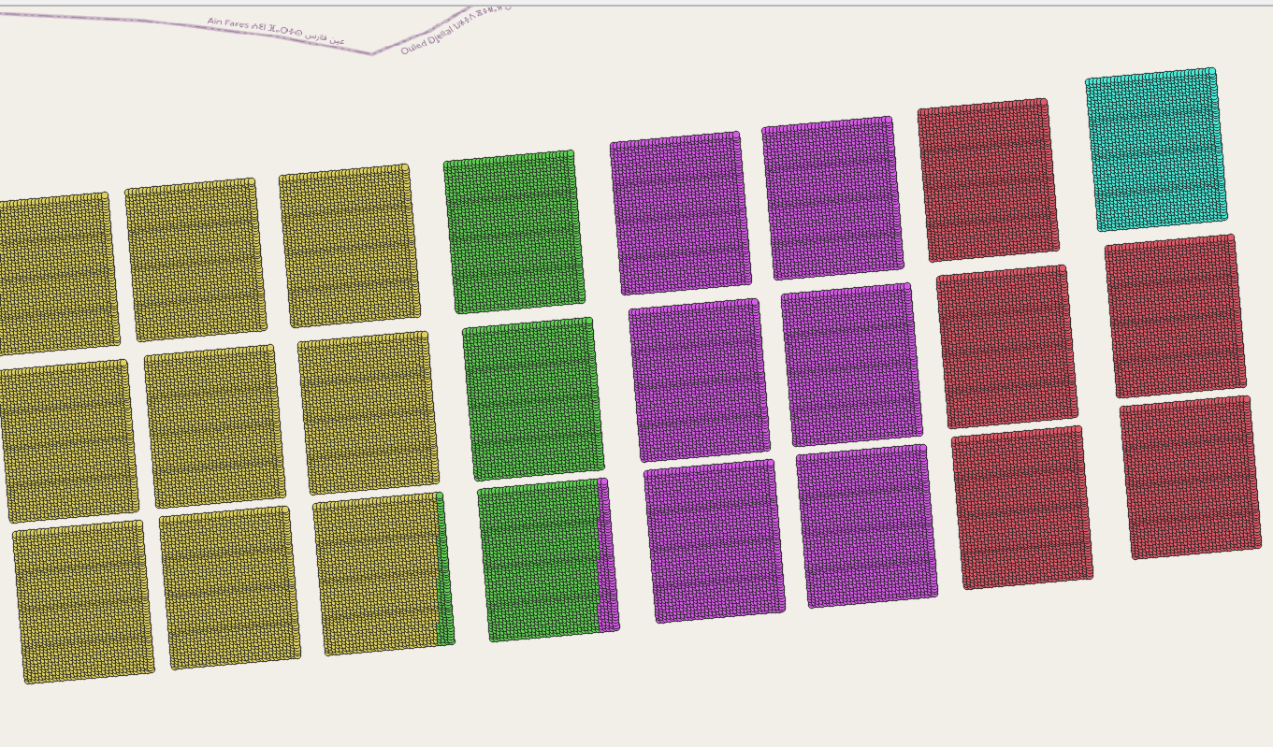
QGIS
At least in Construction Project, you should always start your Map using QGIS
Latitude and Longitude is the exception not the rule WGS 84 CRS, you need first to use QGIS for conversion

Slide 5
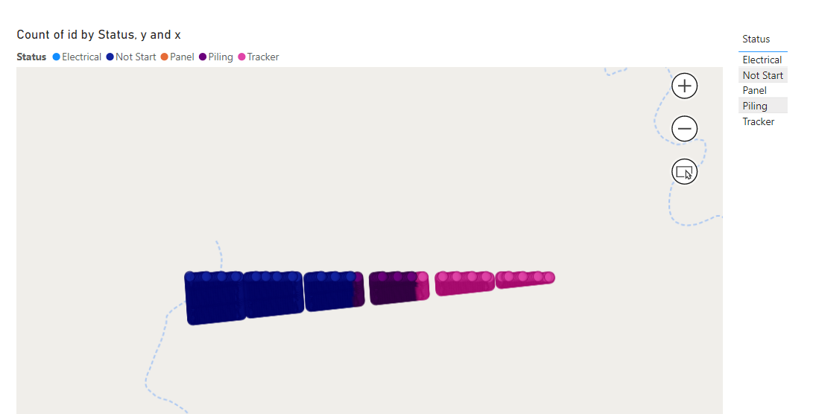
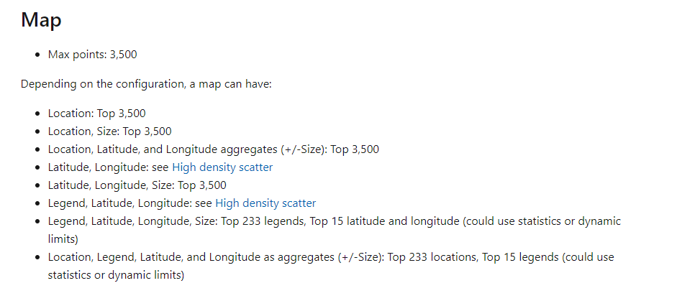
First Try, default PowerBI Map
Public Report

Slide 6
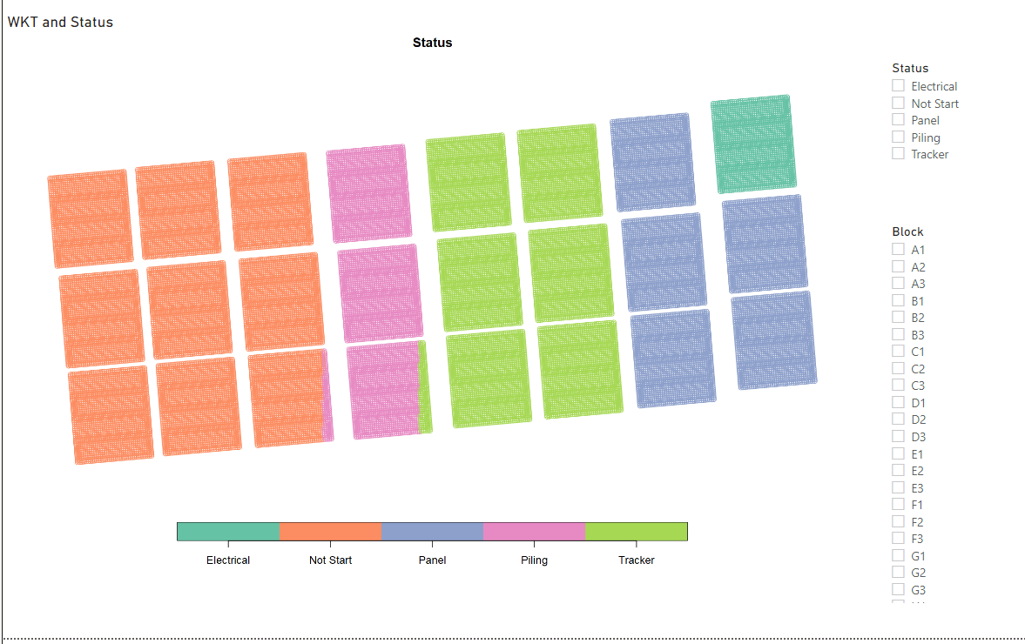
Second Try, R Saved the Day
Public Report
R visual has a limit of 150K points
library(sf)
map = plot(st_as_sf(dataset, wkt ="WKT")["Status"])
map

Slide 7
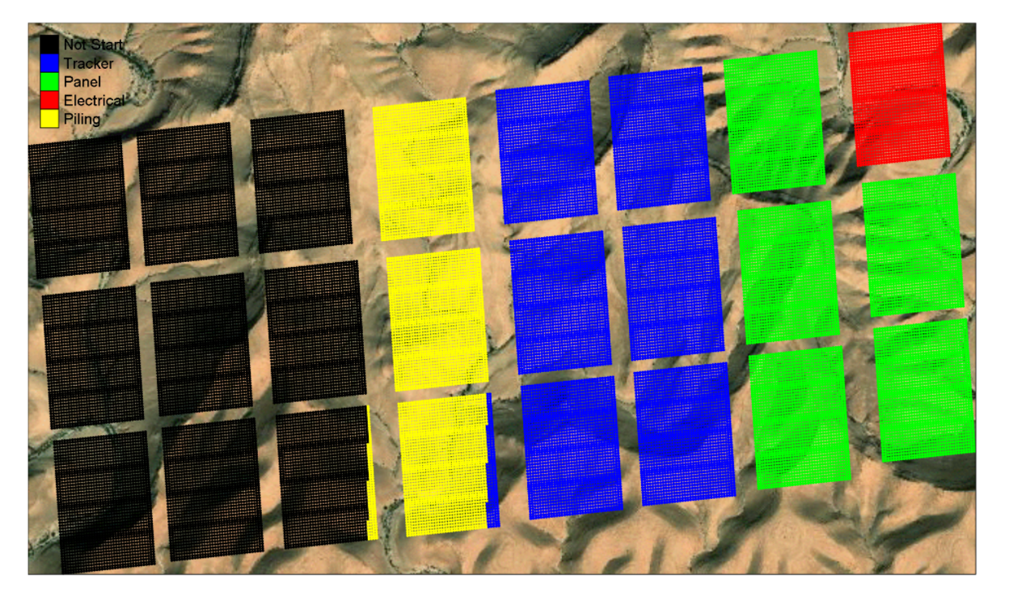
Happy life with R Visual
At that time, I used only PowerBI Desktop we did not have the service
With R you can generate High Quality pdf Print, see blog here
And actually you can even generate self contained interactive HTML Map ( yes that’s not a joke)
Interactive Report ( Using R and Vega-Lite)
Blog here
I even Joined the Local R User Group

Slide 8

We Had PowerBI Service Finally, and everything is broken
R Visual can’t call external resources, it means the background can not be plotted in the service

Slide 9
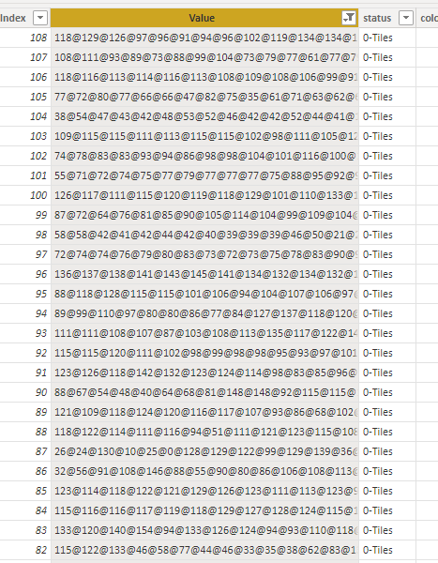
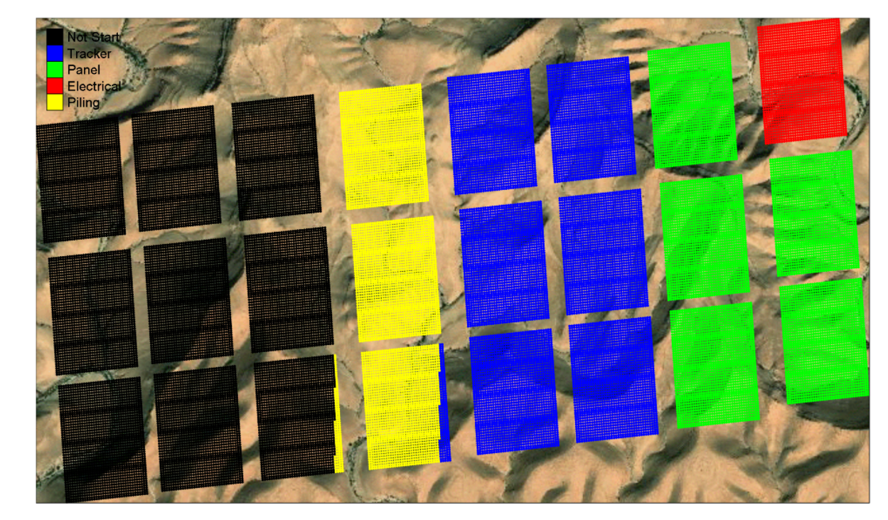
No Problem, you can load a Binary R Object as a text to PowerBI Data Model
This the weirdest hack I have one with PowerBI so far
Blog Post, and R Code

Slide 10
Another Problem !!!
R Performance in the is problematic, see Example
First time I open a ticket
It is by design

Slide 11
No Hope
MapBox is a potential solution at that time, Using tileset

Slide 12
Miracles Happen
Icon Map released Version 2 and it support WKT
https://icon-map.com/
The Genius of Icon map the WKT can be a Measure too, it is dynamic and we can do some cool stuff with

Slide 13
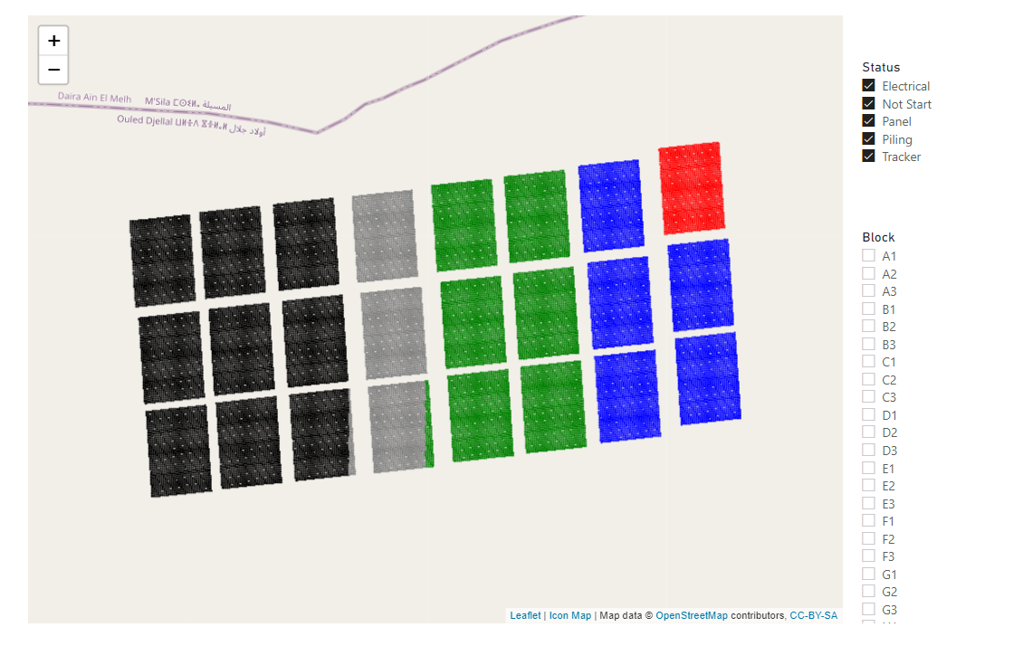
Problem Solved, Geometry simplification, Basically The key of this Presentation
All the points are shown now,
see public Report

Slide 14
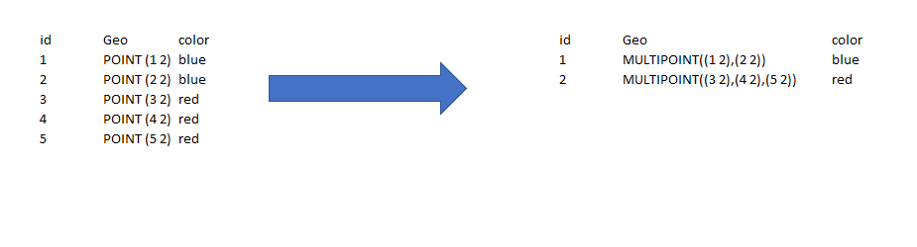
Reduce Geometry from Point to Multi Point
In the Previous Example we went from 42K rows to 26 rows

Slide 15
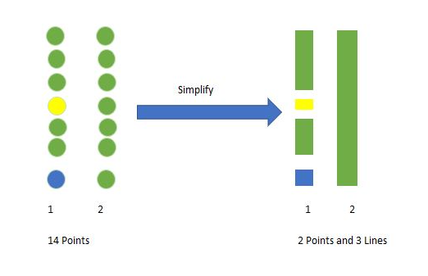
You can Mix Point and line
See Blog for More details, using DAX only
Or Using SQL for more complex Scenarios

Slide 16
Key Findings
Don’t take it personal, If PowerBI don’t support a scenario, Just don’t do it, vote and make some noise
Don’t use Hacks in Production
Icon Map is Awesome ☺

Slide 17
Aggregating Massive GIS datasets (Multi Point and Hexagon)

Slide 18
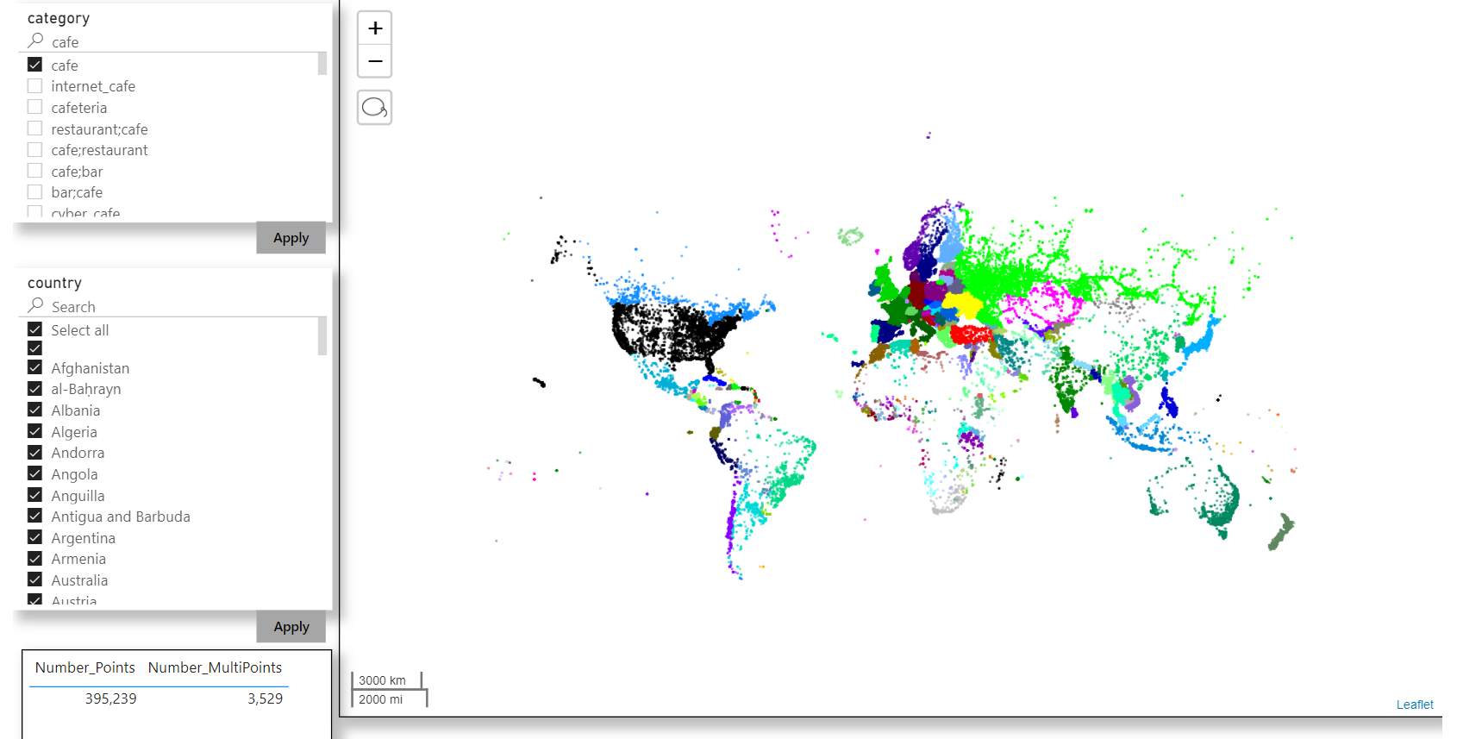
Enough of Solar Farm, trying real life example
See Blog for pbix and howto

Slide 19
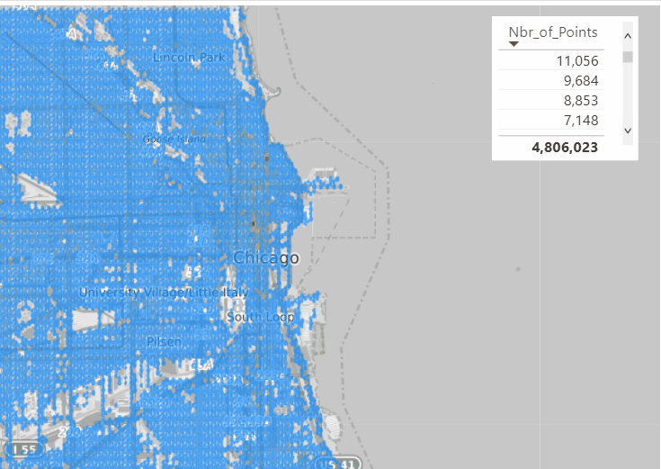
Aggregate by Hexagon

Slide 20
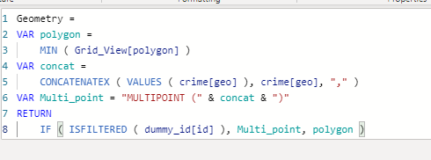
Generate a Grid ( Hexagon or Square)
Join by coordinates
Drill down to individual points
DAX Magic
Blog and Howto here
Publish to web

Slide 21
Nice GIS trick, filter by Distance and calculate Distance

Slide 22
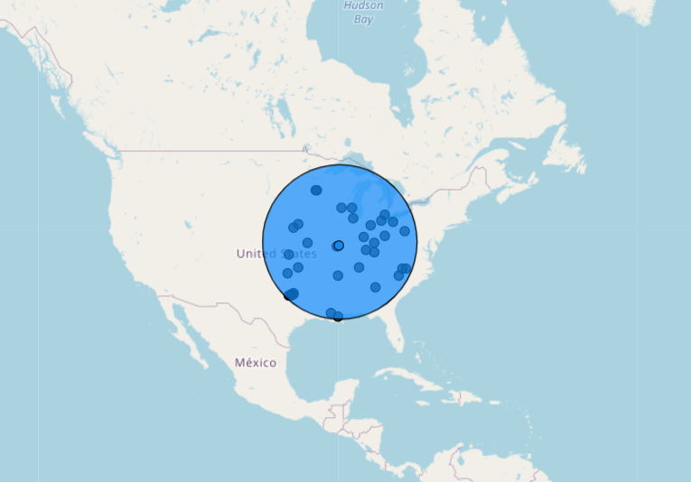
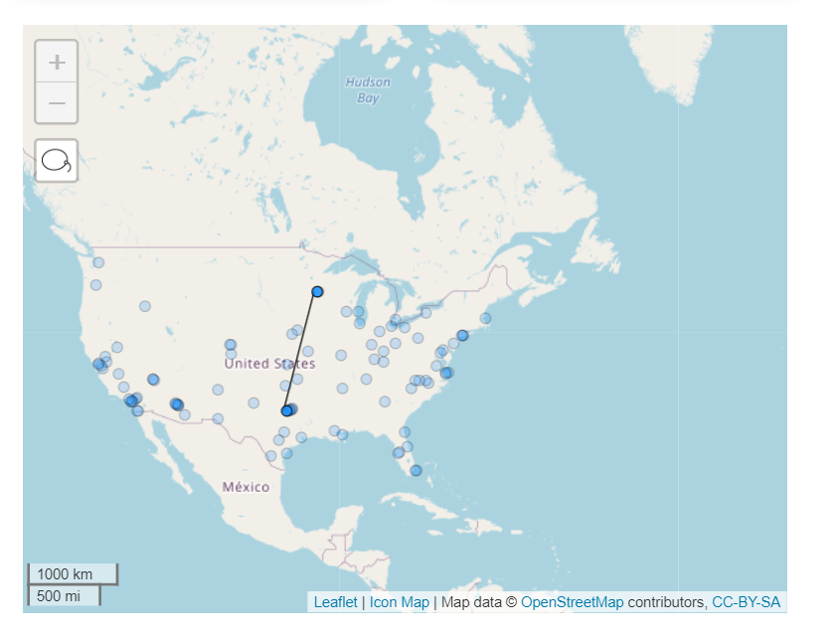
Dynamic Filtering

Slide 23
Dynamic M Parameter

Slide 24
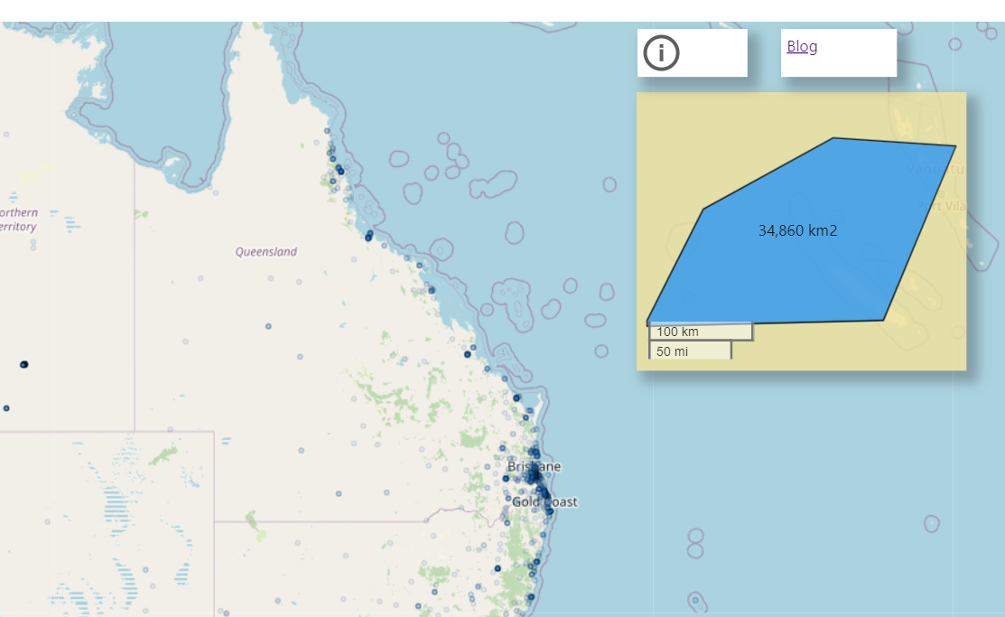
Calculate Area
Publish to Web

Slide 25
Don’t get too Excited it works only with Direct Query and DB that support M Parmeter
Currently only works with BigQuery, snowflake etc
You select the Point using M parameter
BigQuery do the calculation and send back a wkt
Icon Map render it
Blog and howto

Slide 26
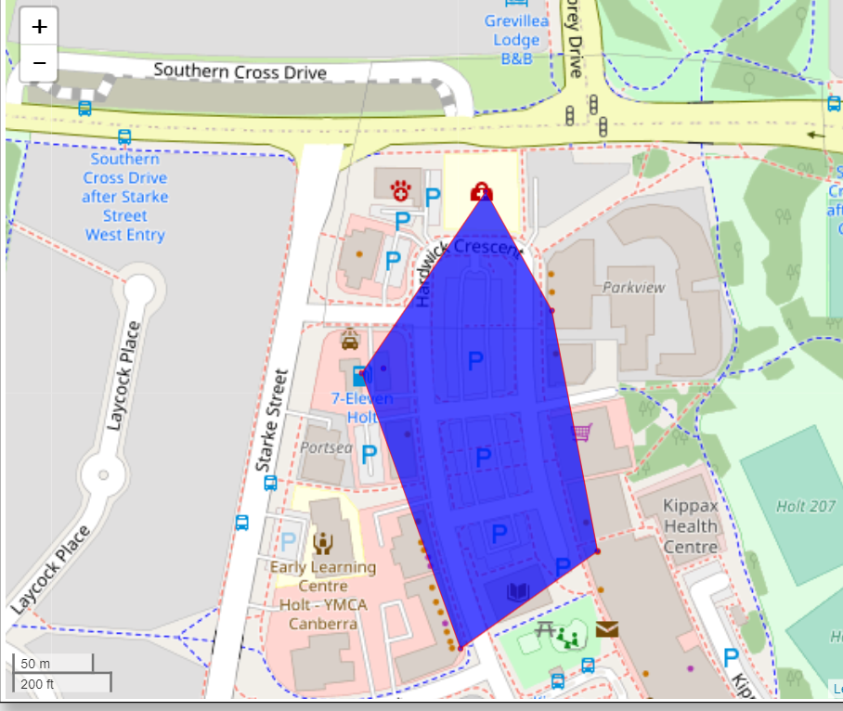
Dynamic Clustering
Publish to Web
Blog and pbix

Slide 27
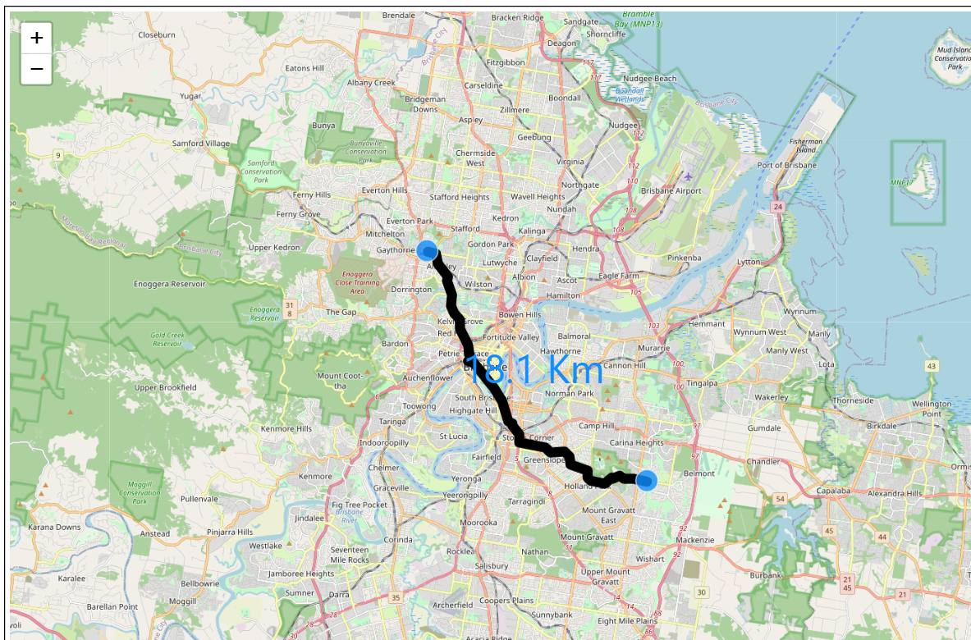
Calculate Road Distance
Private Report, it is rather Slow
Blog and pbix

Slide 28
Need Votes here
Make DAX auto filter itself :)
Make PowerQuery keeps Data type when running SQL Query

Slide 29
How Other BI tools are doing

Slide 30
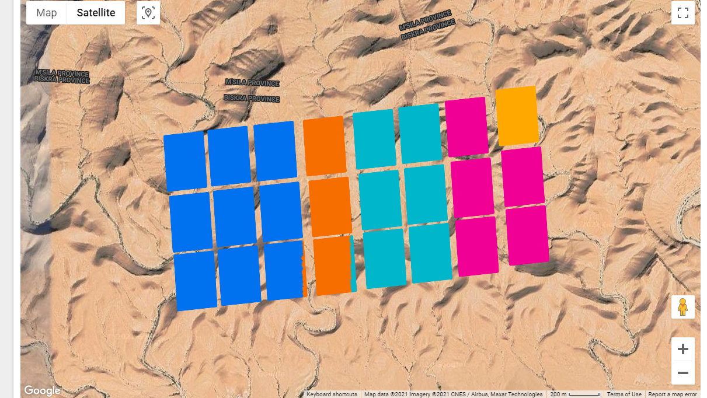
Google Data Studio

Slide 31
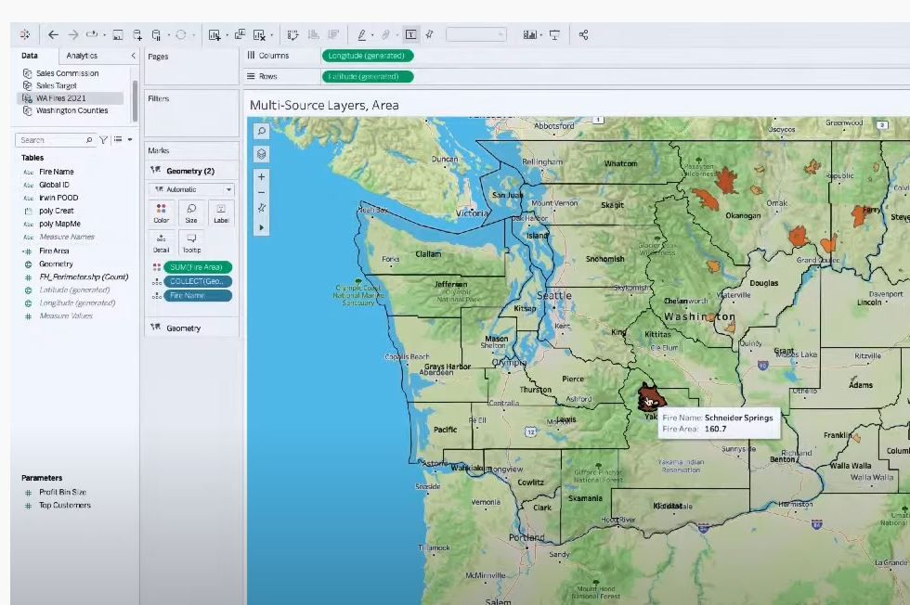
Tableau Multi Dataset Support API

Slide 32
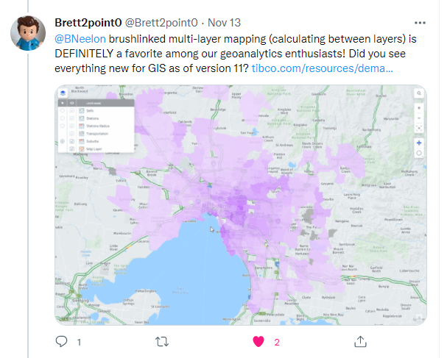
SpotFire had it since 2014

